Slide 1


Search for new physics with vector boson scattering at the ATLAS experiment
LHC run 2 analysis
Harriet Watson
Dong Qichen
Supervised by Prof. Andrew Pilkington
Notes:
H:

Slide 2
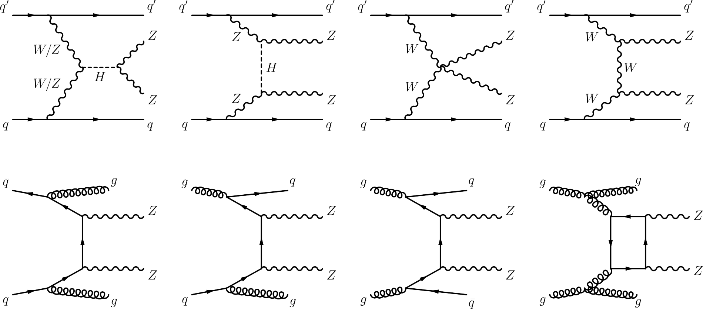
Processes
Signature of vector boson scattering processes is VVjj
Vector
Boson
Scattering
QCD
backgrounds
Notes:
D: in the PP, signature, QCD. llll channel.

Slide 3
Probing electroweak symmetry breaking (EWSB)
Extra source of CP violation in the EW sector
Notes:
H: detector

Slide 4
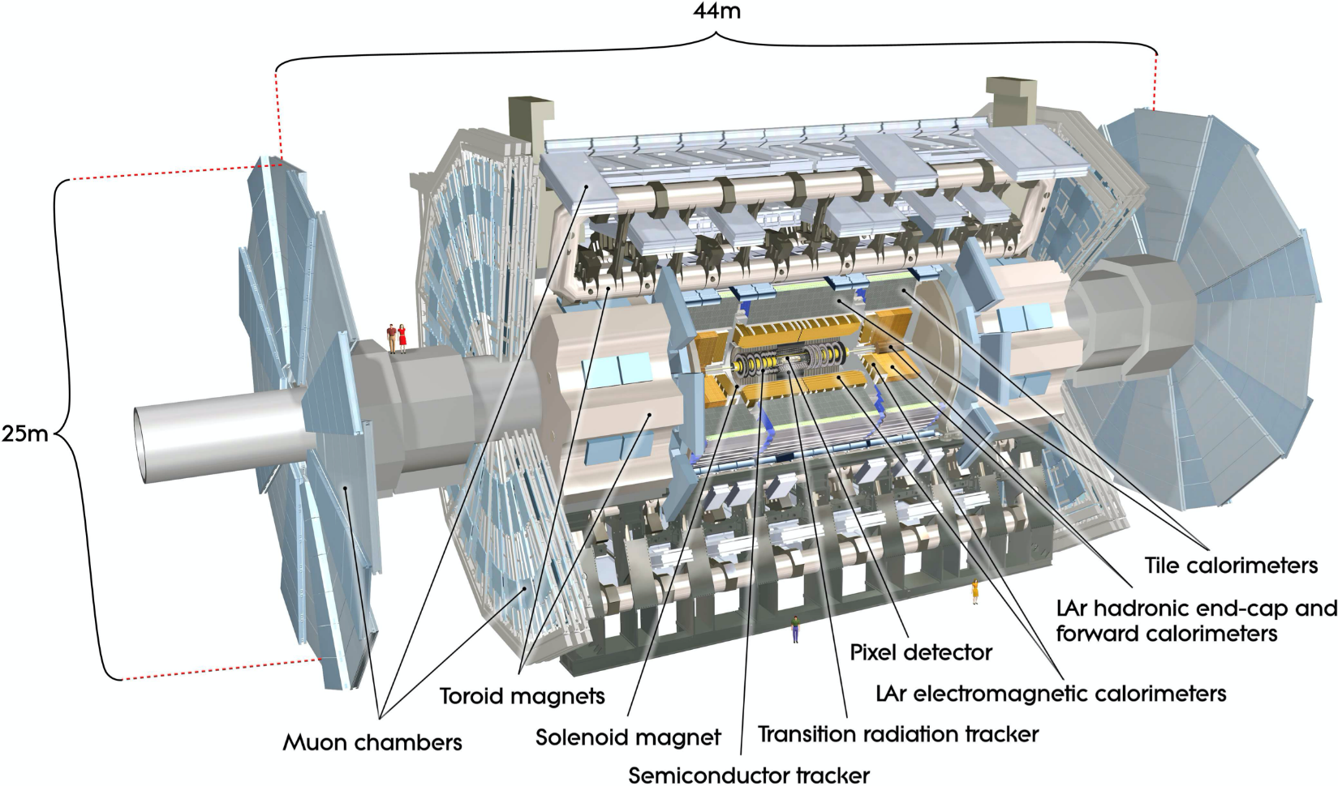
The ATLAS detector
Credit: The ATLAS Collaboration. The ATLAS experiment at the CERN large hadron collider. J Instrum.
Notes:
H: detector

Slide 5
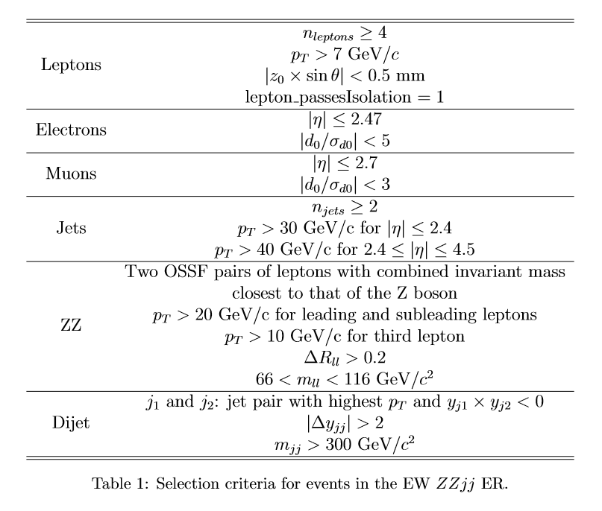
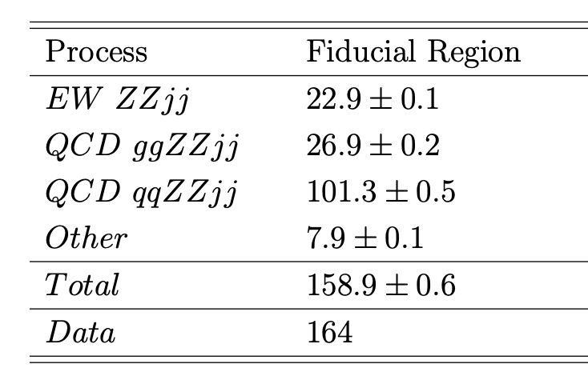
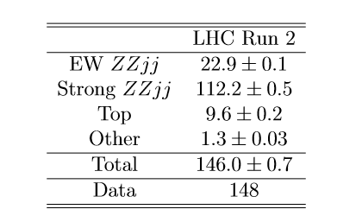
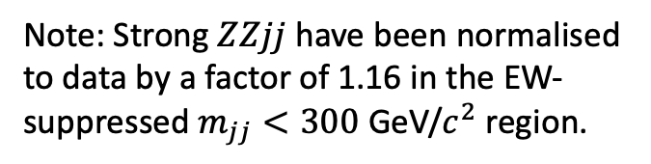
Events selection and yields
Note: Strong $ZZjj$have been normalised to data by a factor of 1.16 in the EW-suppressed $m_{jj}<300$ GeV/$c^{2}$ region.
Notes:
D: the reco of these events relies on… selection diff, but high dijet invariant mass with on-shell Z.
H:

Slide 6
Investigation into background mismodelling
Notes:
Harriet: Our Mphys project is titled serach for new physics with vector boson scattering at the ATLAS experiment
Looking at rare physics process to hopefully find some beyond the SM physics

Slide 7
Mismodelling in Strong ZZjj
The separation of EW ZZjj from the irreducible background is one of the main issues when using EW ZZjj for new physics searches.
Most separation techniques rely on simulated events from MC event generators.
Mismodelling in Strong ZZjj by MC event generators has been observed, particularly at values of high $m_{jj}$.
Ignoring the mismodelling may make separation techniques less effective than they could be.

Slide 8
Nominal method:
no reweighting for the mismodelling of Strong ZZjj
main systematic uncertainty arises from the choice of MC generator
Reweighting method:
Strong ZZjj distribution is reweighted as a function of $m_{jj}$
main systematic uncertainty is due to statistical uncertainty on the reweighting function

Slide 9

Test distributions
The search for the EW ZZjj can be performed in the distribution of $m_{jj}$. However, due to the large irreducible background, machine learning techniques for classification such as boosted decision trees (BDTs) are favoured.
$$n_{\left\{jets\right\}}≥2$$
Using truth information, BDTs can “learn” the properties of simulated events in order to classify data.
The classification is returned in the form of a “response”, a number between -1 (background-like) and 1 (signal-like) for each event.
The significance of the BDT response distribution may also be calculated.
$$n_{\left\{leptons\right\}}≥4$$
background
background
signal
background

Slide 10
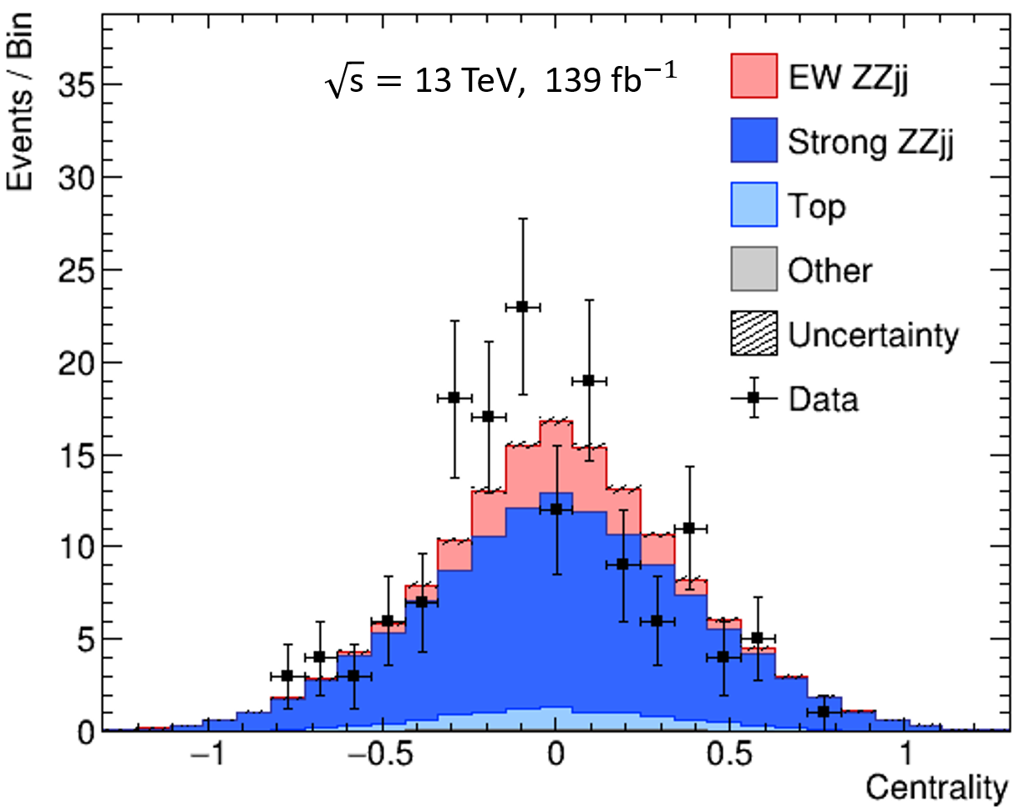
Signal and control regions
Centrality, $C$, is used to define the signal and control regions:
$$C= \frac{y_{ZZ}−y_{jj}}{{∆y}_{jj}}$$
where $y_{ZZ}$ and $y_{jj}$ are the rapidities of the ZZ and dijet system and ${∆y}_{jj}=\left|y_{j_{1}}−y_{j_{2}}\right|$.
$\left|C\right|<0.4 :$ signal region (SR), $\left|C\right|> 0.4 :$ control region (CR)

Slide 11
Log likelihood ratio
where
$n_{i}$ is the number of data events for observed likelihood, $n_{i}=s_{i}+b_{i}$ for expected likelihood,
$s_{i}$ is the number of signal events,
$b_{i}$ is the number of background events in bin i,
$μ$ is the signal strength parameter,
$\hat{μ}$ is the value of $μ$ that maximises the likelihood.
Expectation value of a number of data events: $E\left(n_{i}\right)= μs_{i}+b_{i}$
Likelihood: $L\left(μ\right)= \prod_{i}{\frac{{\left(μs_{i}+b_{i}\right)}^{n_{i}}}{n_{i}!}}e^{−\left(μs_{i}+b_{i}\right)}$
Log likelihood:
$$\ln{L\left(μ\right)}= \sum_{i}{n_{i}\ln{(μs_{i}+b_{i})}} − \ln{n_{i}!}−\left(μs_{i}+b_{i}\right)$$
Log likelihood ratio:
$$λ\left(μ\right)=ln\frac{L\left(μ\right)}{L\left(\hat{μ}\right)}=\ln{L\left(μ\right)} −\ln{L\left(\hat{μ}\right)}$$
Test statistic:
$$t_{0}=−2\ln{λ\left(0\right)}$$
$$p value= erfc⁡\left(\sqrt{\frac{t_{0}}{2}}\right)$$
where $erfc$ is the complementary error function.
We obtain an expected $\hat{μ}$ , an observed $\hat{μ}$ and corresponding significances.

Slide 12
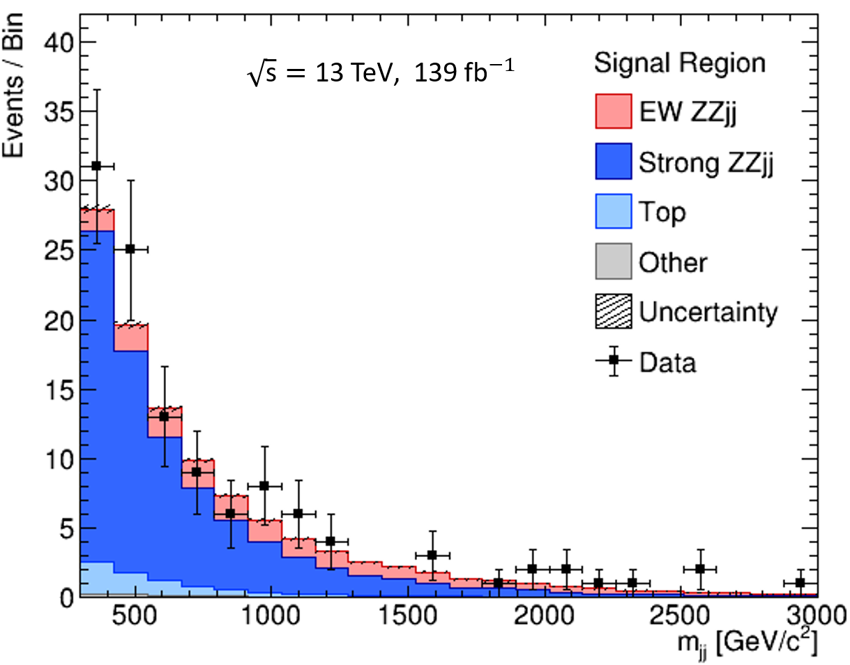
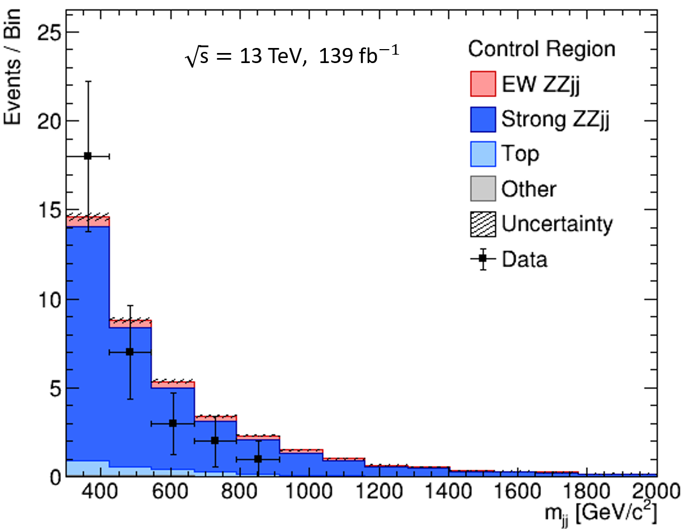
Nominal method
Expected (observed) significance in distribution of $m_{jj}=2.5 \left(3.8\right) σ$

Slide 13
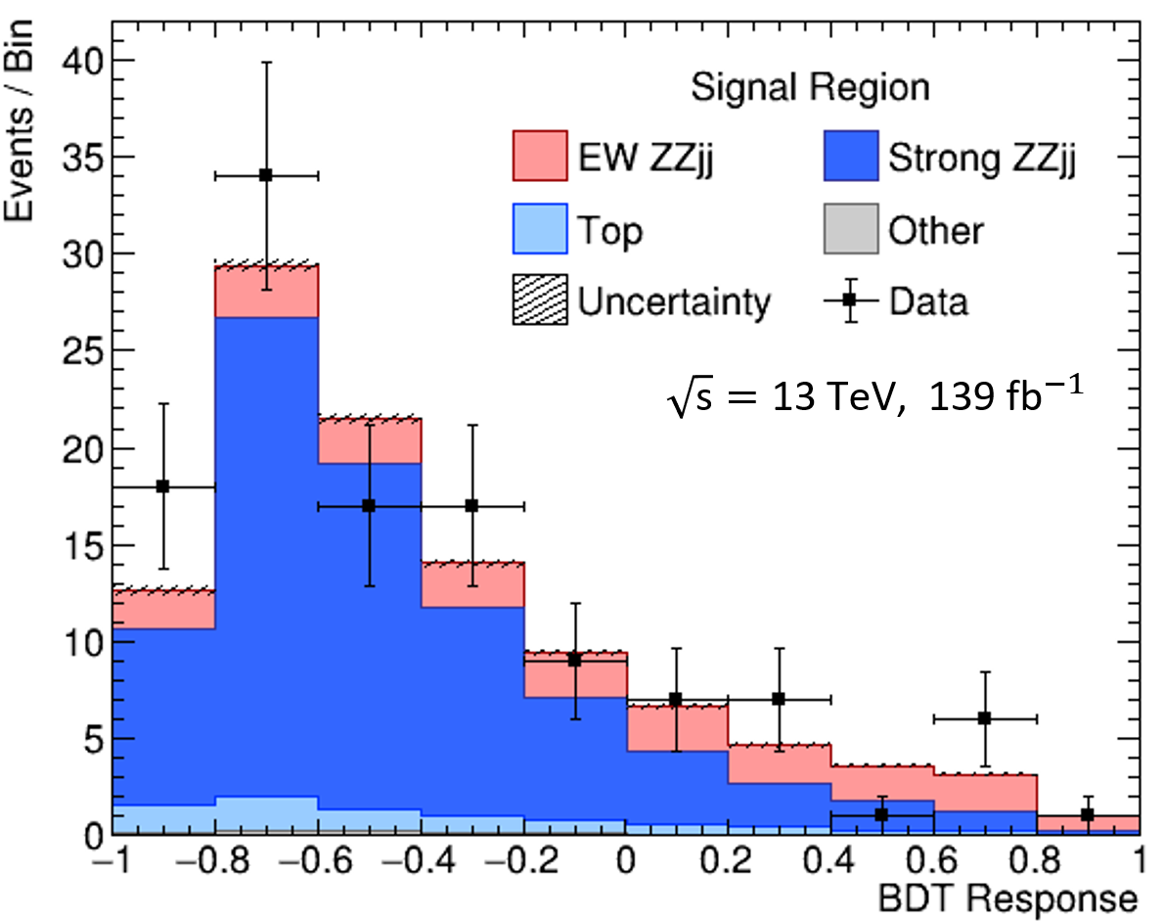
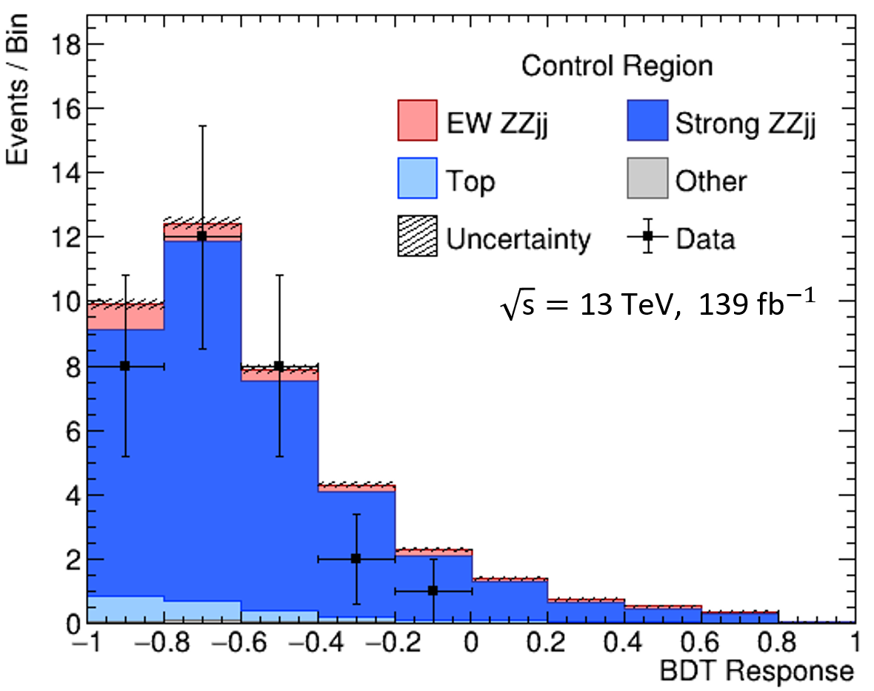
Nominal method
Expected (observed) significance in distribution of BDT response $=2.8 \left(3.8\right) σ$

Slide 14
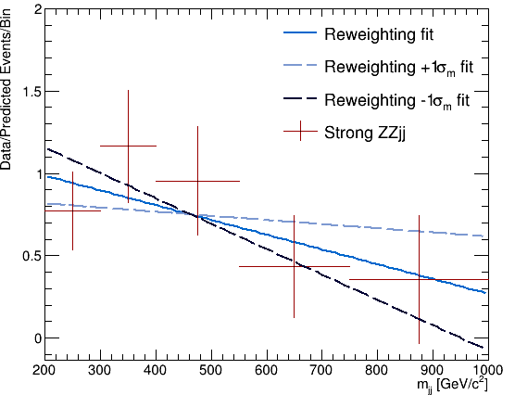
Reweighting method
Linear function fit to the ratio of data/predicted Strong ZZjj distribution of $m_{jj}$ in the CR.
Strong ZZjj data/predicted = $\frac{\text{data} − \text{non}\text{−}\text{Strong} \text{ZZjj}}{\text{Strong} \text{ZZjj}}$
Gradient of nominal reweighting function:
$m ± σ_{m}=−0.000896±0.00064$5
The reweighting function was not allowed to return negative reweighting factors.
$$y=−0.00025x+0.87$$
$$y=−0.000896x+1.17$$
$y=−0.00154x+1.4$6

Slide 15
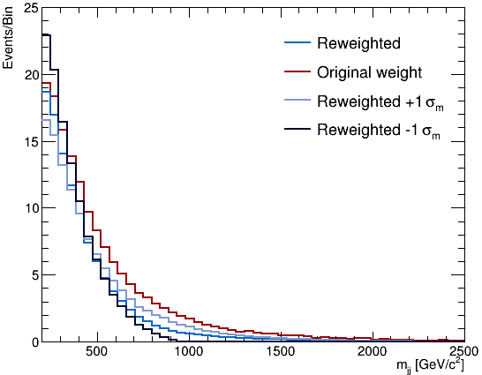
Reweighted $m_{jj}$

Slide 16

Reweighting method results
Reweighting changed the shape of BDT response distribution in an unpredictable way and it was determined that further investigations were needed. Therefore only the results for the $m_{jj}$ distribution are shown:
 | Significance Exp. (Obs.)
No reweighting | $2.5 \left(3.8\right) σ$
Nominal reweighting | $$3.7\left(8.1\right) σ$$
$+1σ_{m}$ reweighting | $3.4\left(7.0\right) σ$
$−1σ_{m}$ reweighting | $5.2\left(11.7\right) σ$
‘No reweighting’ result is from the nominal method, though the significances are not directly comparable without a full consideration of the statistical and systematic uncertainties.

Slide 17
Uncertainties
Statistical uncertainties on both nominal and reweighting methods can be obtained from the log likelihood ratio plotted as a function of $μ$.
Systematic uncertainty on the nominal method was obtained using a Powheg MC sample for the main Strong ZZjj process in place of the Sherpa sample used otherwise.
Systematic uncertainty on the reweighting method was found using additional log likelihood ratio tests comparing the consistency of the nominal and $±1σ_{m}$ reweighting functions.
 | Expected $\hat{μ}$
Nominal method | ${1.00}_{−0.51}^{+0.54}$
Reweighting method | ${1.00}_{−0.44}^{+0.55}$

Slide 18
Conclusions on background mismodelling
The nominal and reweighting methods have similar total uncertainty as evaluated here.
It is not fully understood how reweighting affects the BDT response distribution and this should be investigated.
Reweighting may be a useful technique when more data becomes available during LHC Run 3 and HL-LHC.

Slide 19
Constraints on BSM vector boson interactions in an effective field theory
Notes:
Harriet: Our Mphys project is titled serach for new physics with vector boson scattering at the ATLAS experiment
Looking at rare physics process to hopefully find some beyond the SM physics

Slide 20
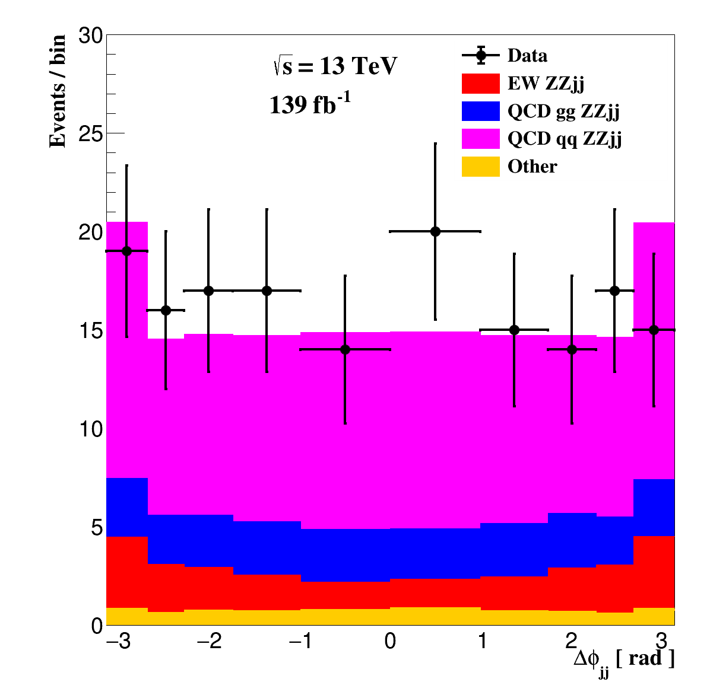
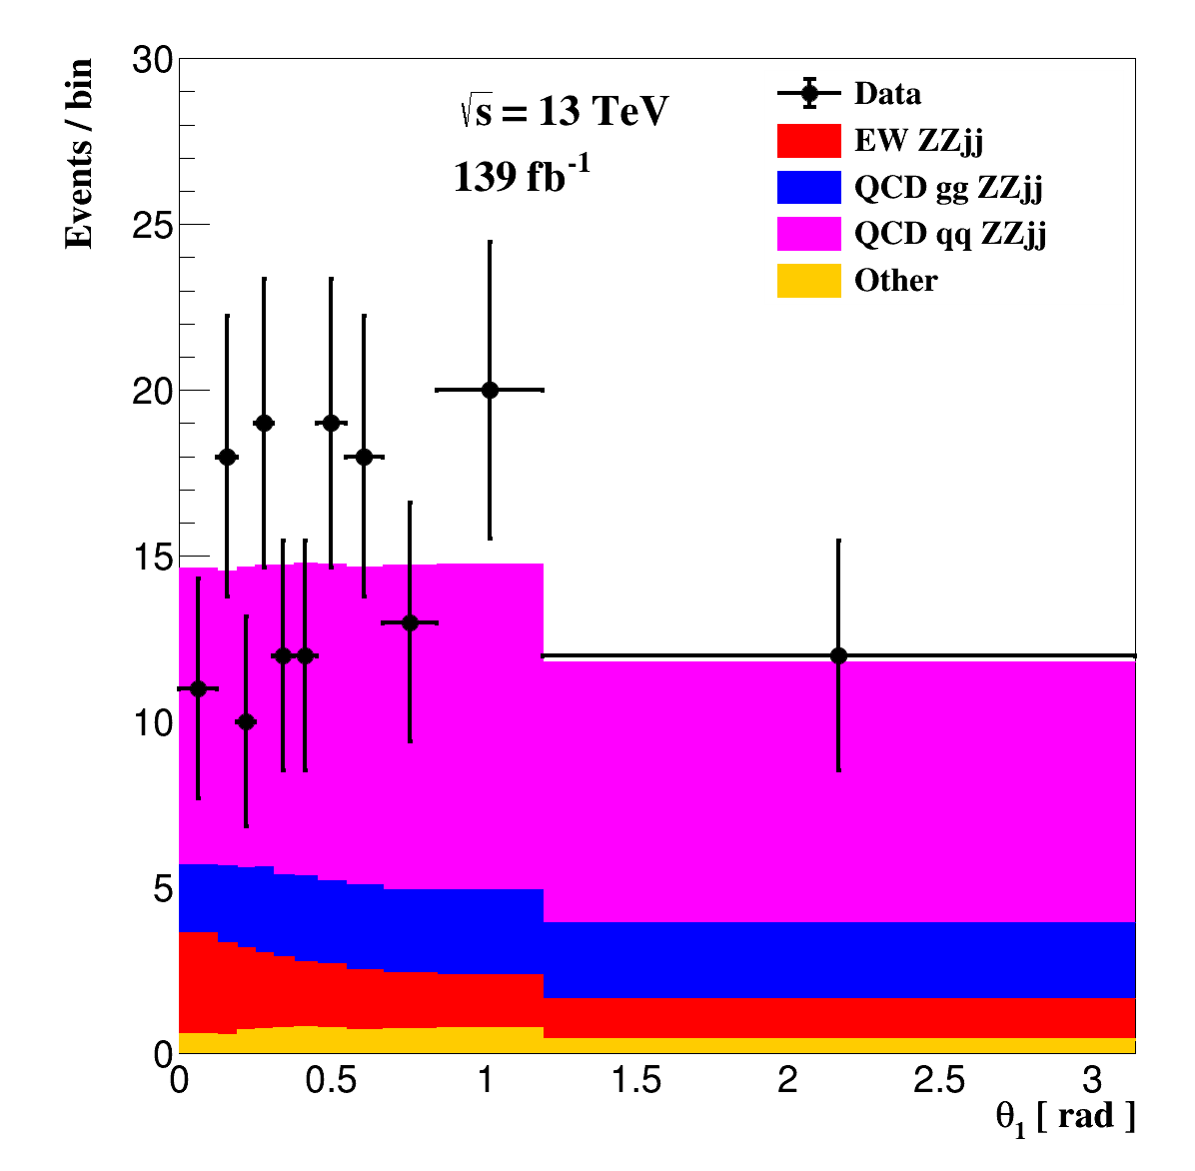

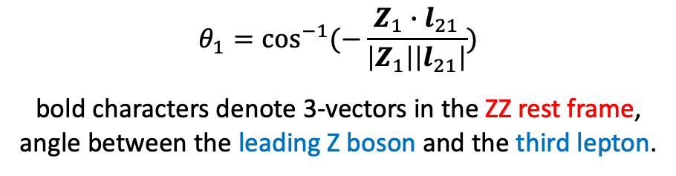
Distributions of interest
$$Δφ_{jj}=φ_{j1} −φ_{j2}$$
The order is arranged according to the rapidities of the two jets,
the first jet is always the most forwarding jet in the z-axis
$$θ_{1}=\cos^{−1}{(−\frac{Z_{1}∙l_{21}}{\left|Z_{1}\right|\left|l_{21}\right|})}$$
bold characters denote 3-vectors in the ZZ rest frame,
angle between the leading Z boson and the third lepton.

Slide 21
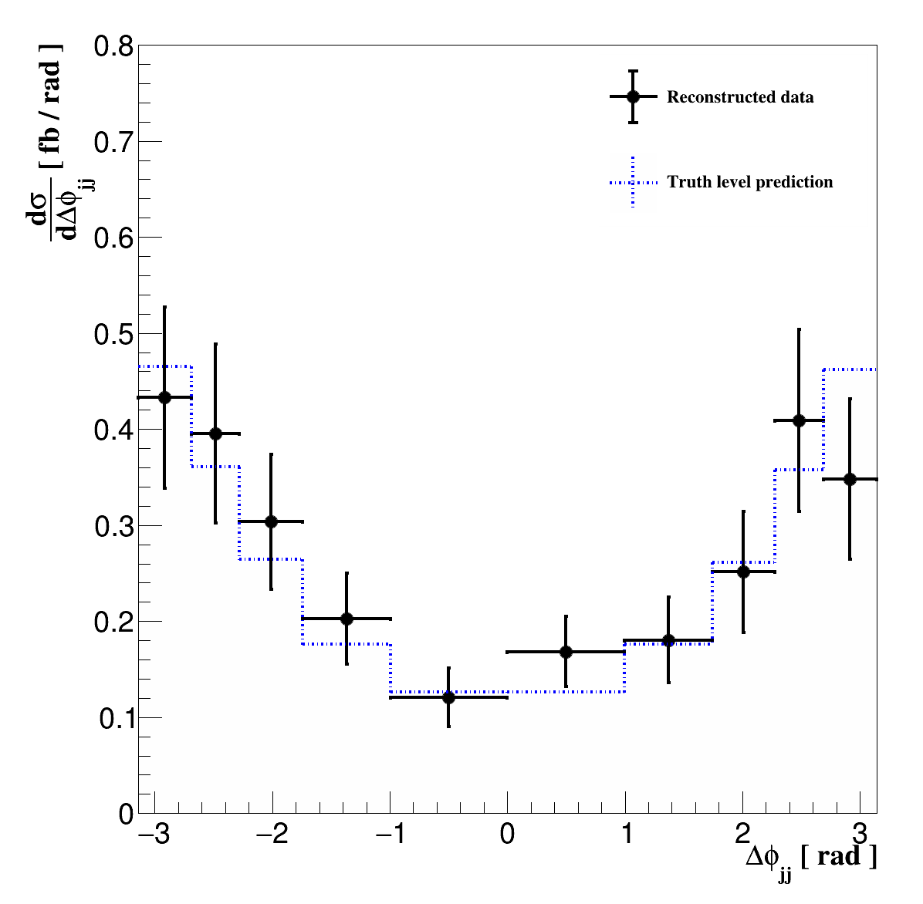
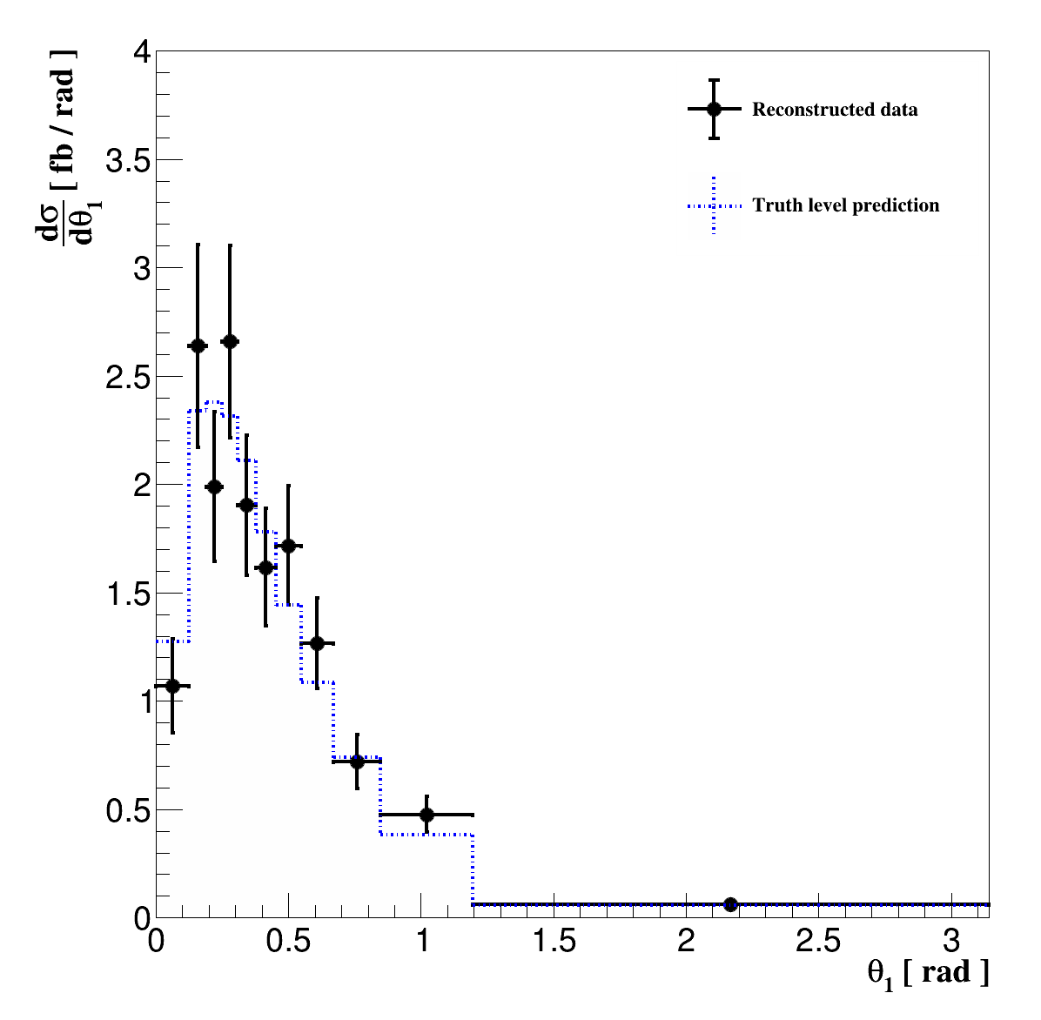
Unfolding
Removes detector effects, results can be compared with truth-level prediction
Gives covariance between bins

Slide 22
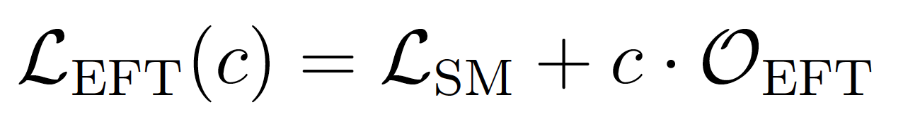
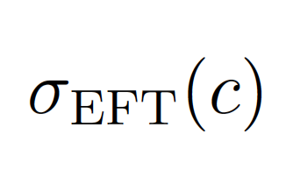
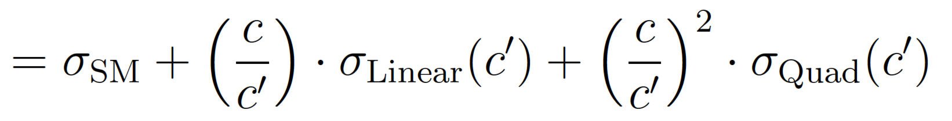
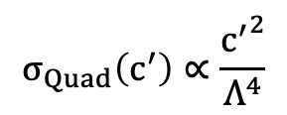
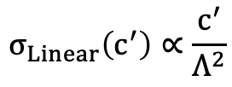
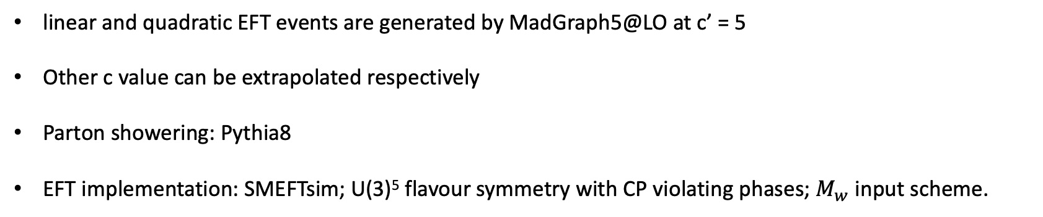
EFT events generation
EFT cross section
$$σ_{Linear}\left(c^{′}\right)∝\frac{c^{′}}{Λ^{2}}$$
$$σ_{Quad}\left(c^{′}\right)∝\frac{{c^{′}}^{2}}{Λ^{4}}$$
Technical detail
linear and quadratic EFT events are generated by MadGraph5@LO at c’ = 5
Other c value can be extrapolated respectively
Parton showering: Pythia8
EFT implementation: SMEFTsim; U(3)⁵ flavour symmetry with CP violating phases; $M_{w}$ input scheme.

Slide 23
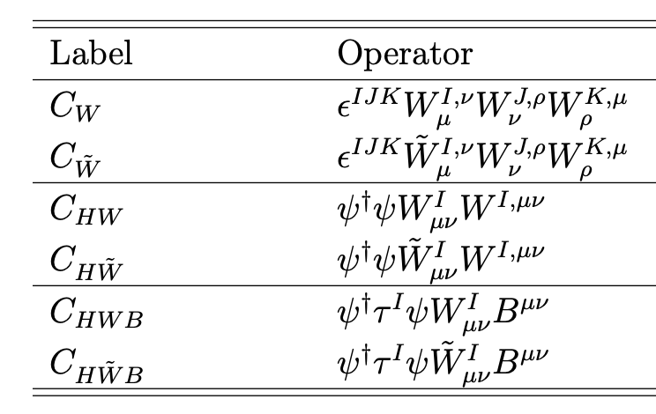
Studied Wilson coefficients
Relevant Vertices
VVV
HVV
HVV and Vqq

Slide 24
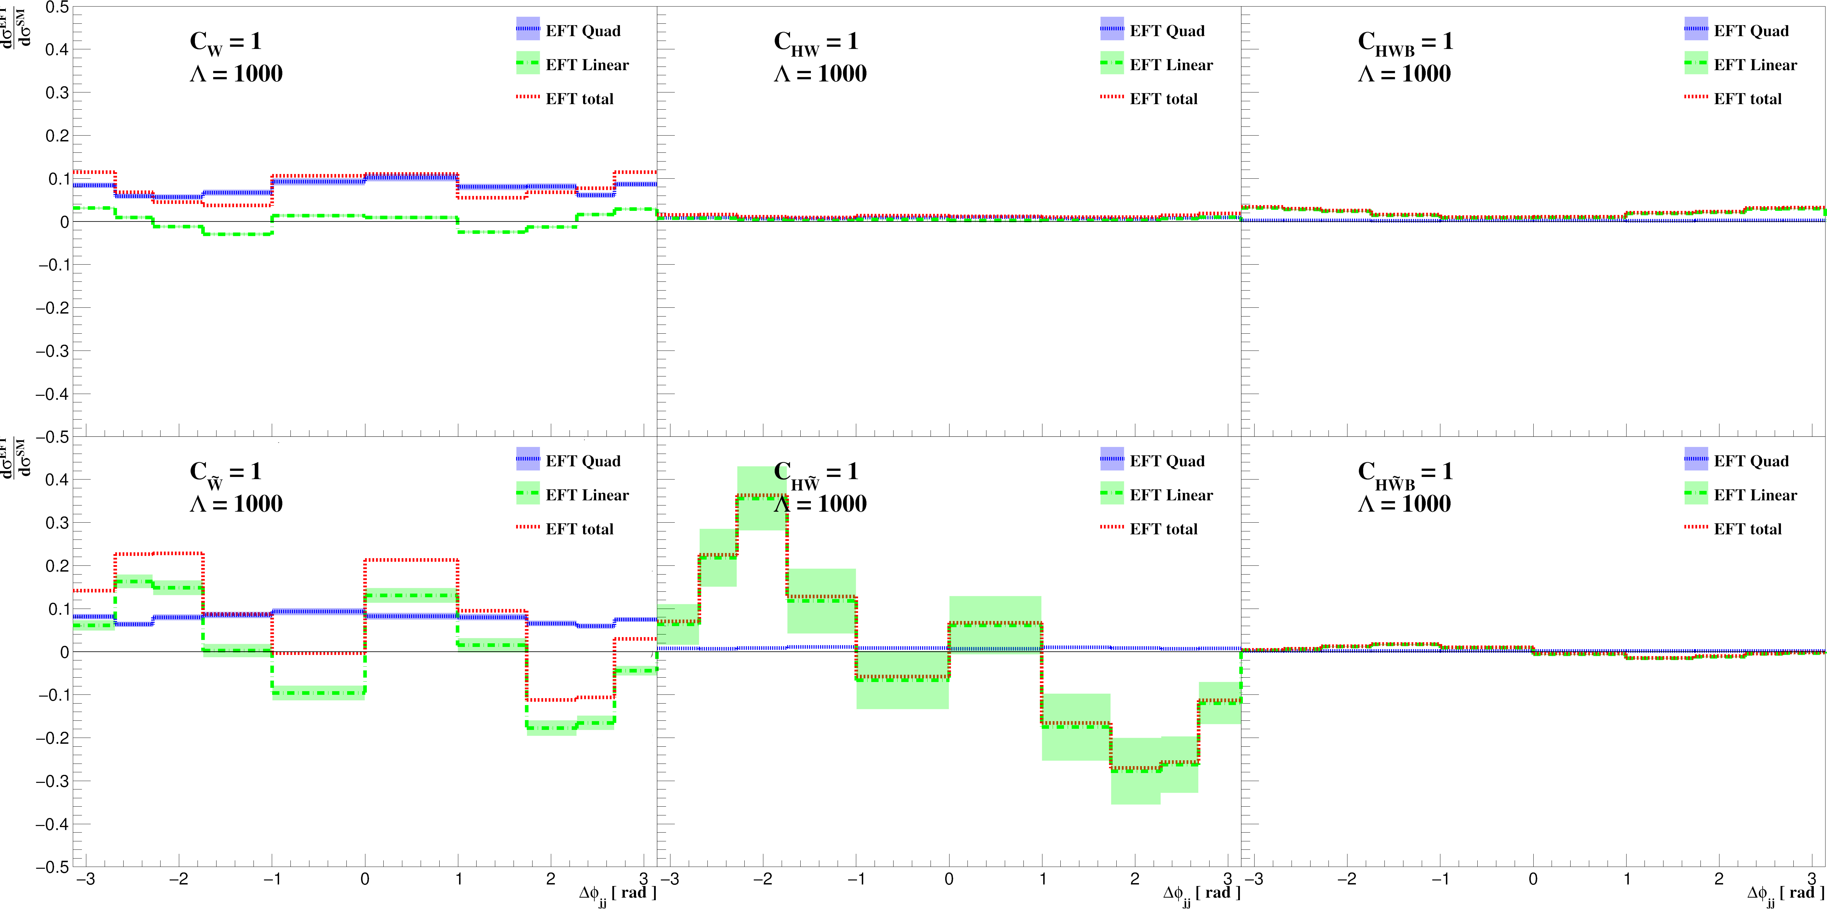
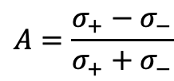
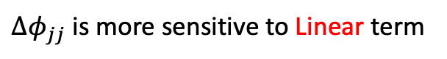
EFT kinematics
$Δφ_{jj}$ is more sensitive to Linear term
$$A=\frac{{σ_{+}−σ}_{−}}{σ_{+}+σ_{−}}$$

Slide 25
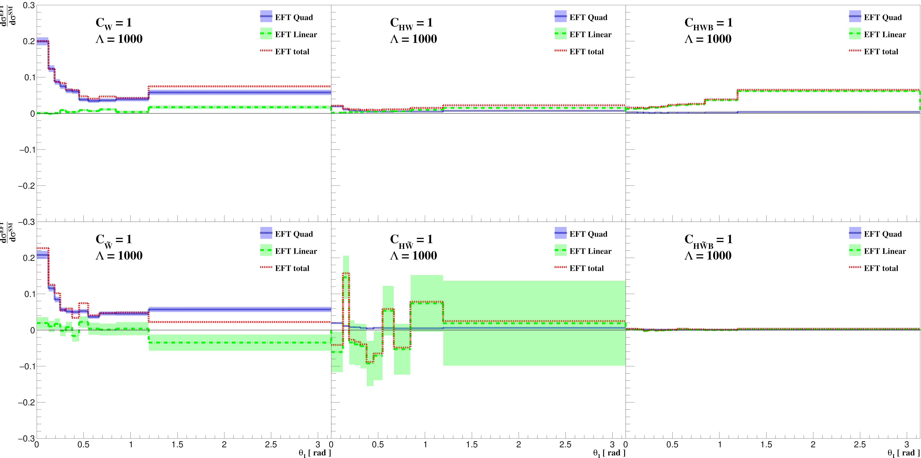
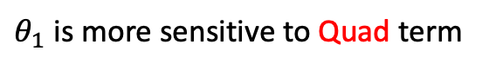
EFT kinematics
$θ_{1}$ is more sensitive to Quad term

Slide 26
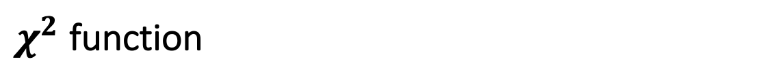
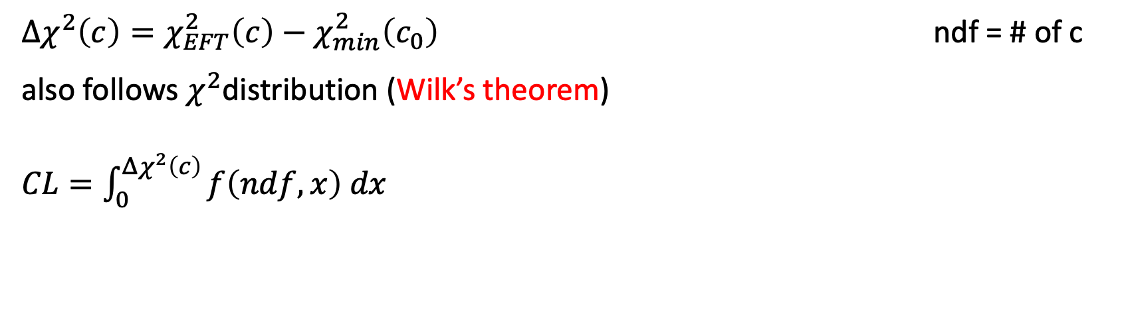



$χ^{2}$ function
$χ_{SM}^{2}=χ_{EFT}^{2}(0)={\left(y_{data}−y_{SM}\right)}^{T}Cov^{−1}(y_{data}−y_{SM})$ ndf = # of bins
$χ_{EFT}^{2}(c)={\left(y_{data}−y_{EFT}\left(c\right)\right)}^{T}Cov^{−1}(y_{data}−y_{EFT}(c))$ ndf = # of bins
where $y_{EFT}\left(c\right)= y_{SM}+{\left(\frac{c}{c^{′}}\right)y}_{Linear}\left(c^{′}\right)+{{\left(\frac{c}{c^{′}}\right)}^{2}y}_{Quad}\left(c^{′}\right)$
$Δχ^{2}\left(c\right)=χ_{EFT}^{2}\left(c\right)−χ_{min}^{2}\left(c_{0}\right)$ ndf = # of c
also follows $χ^{2}$distribution (Wilk’s theorem)
$CL=\int_{0}^{Δχ^{2}\left(c\right)}{f\left(ndf, x\right) dx}$
Statistical uncertainties are treated as Gaussian
No uncertainty on SM or EFT predictions (fixed hypothesis)

Slide 27
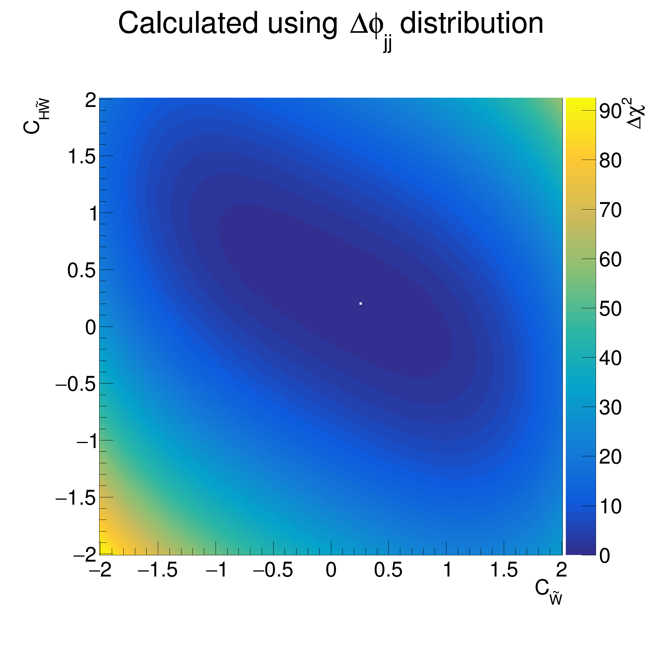
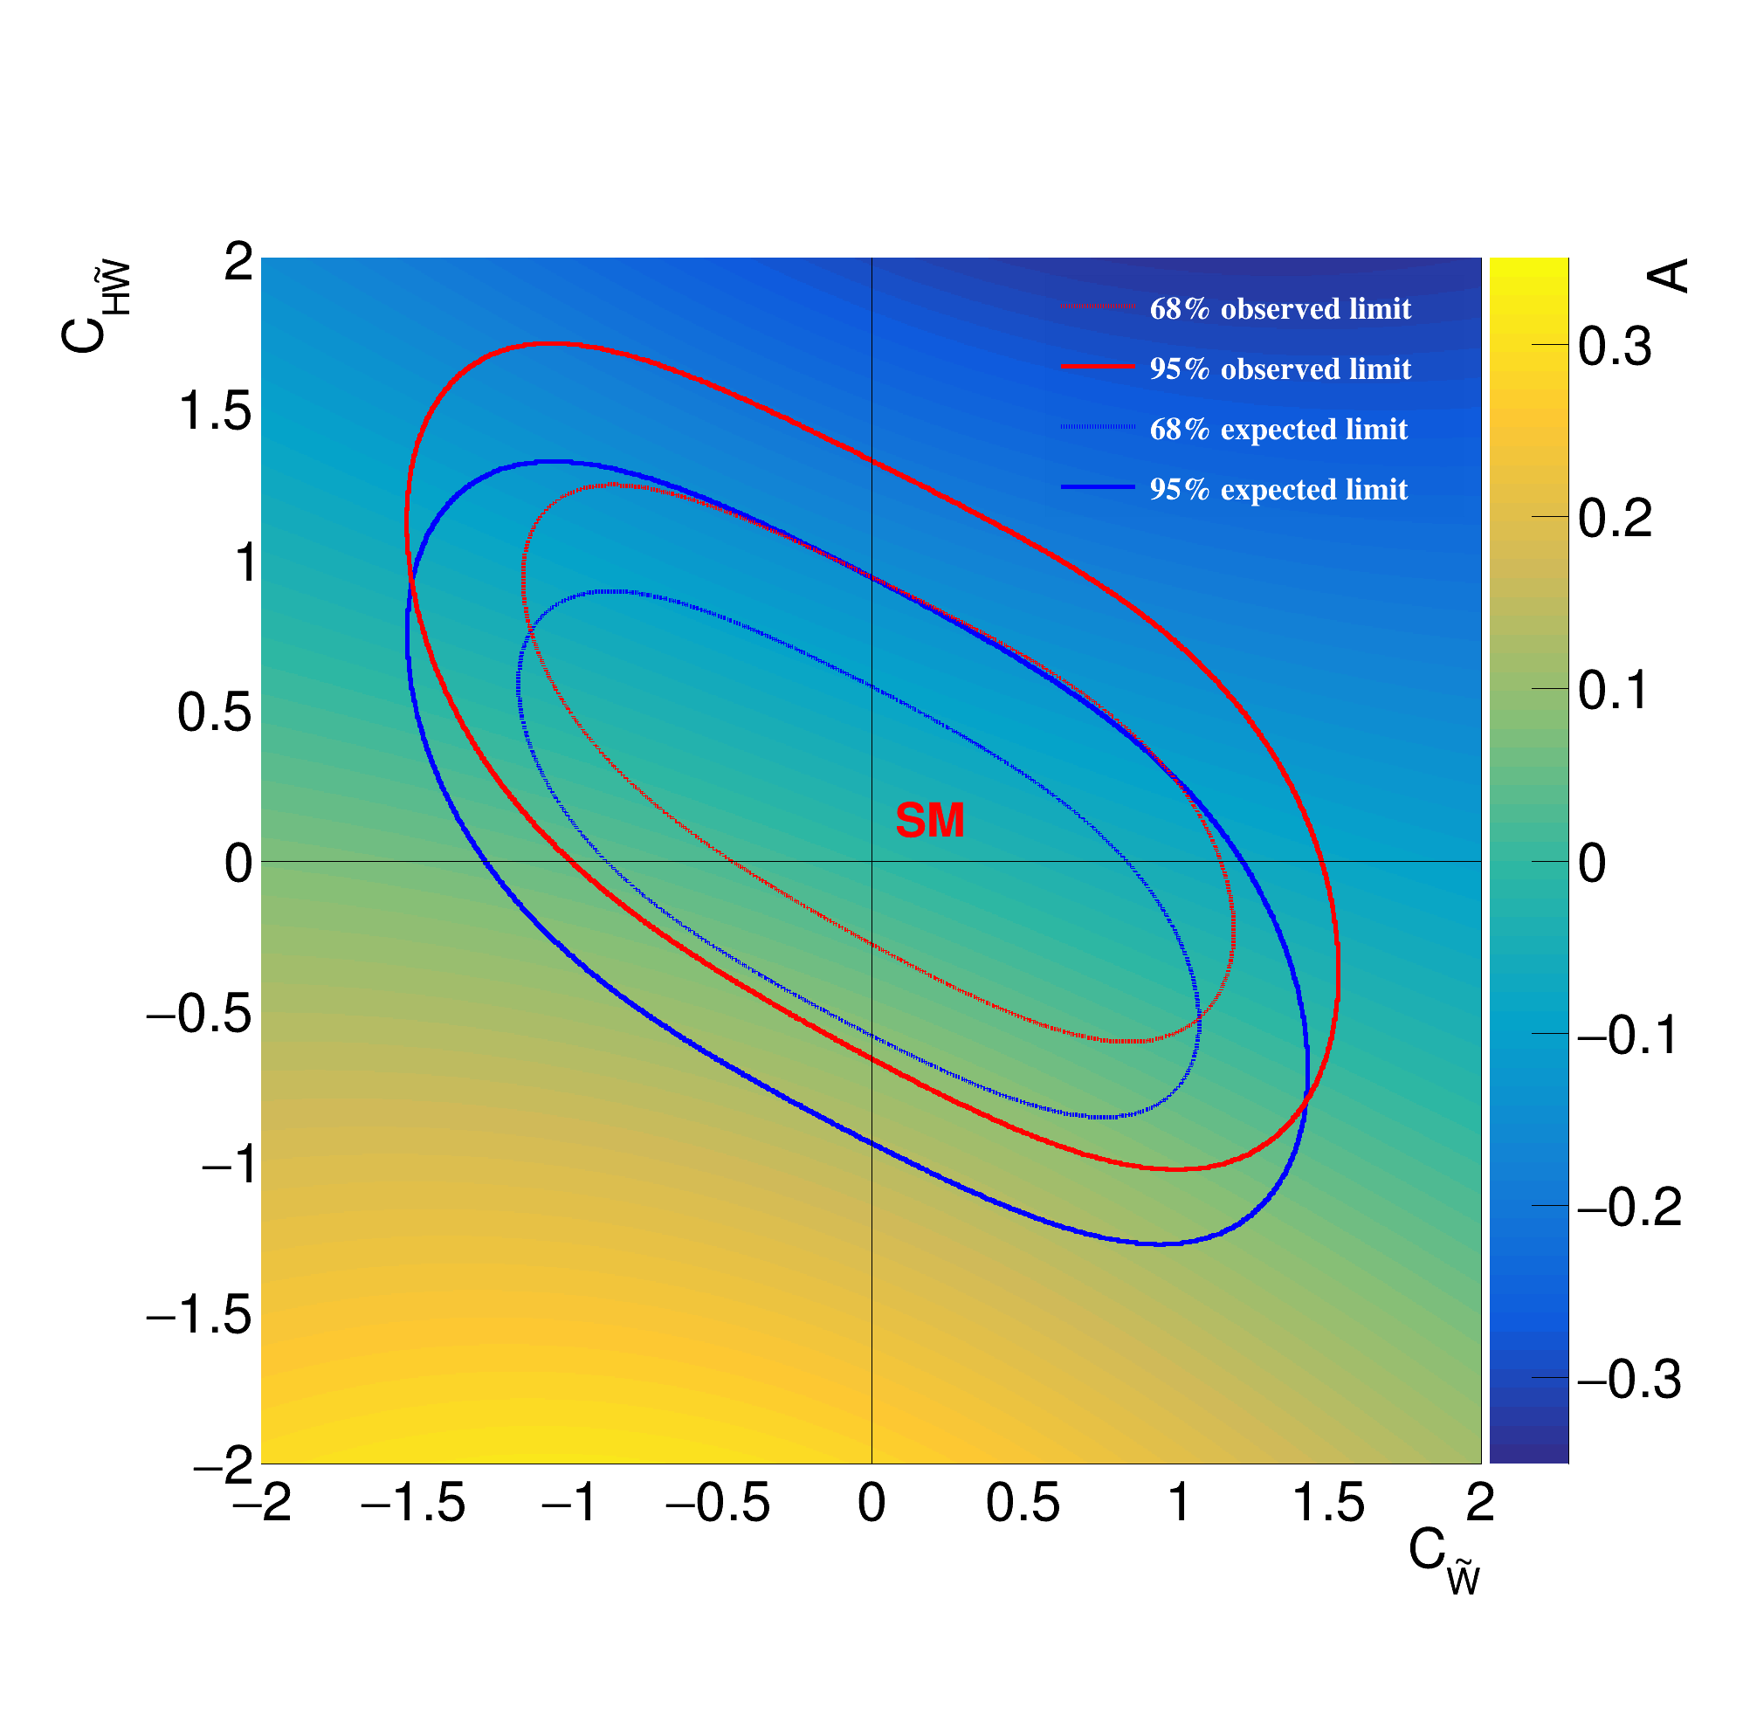
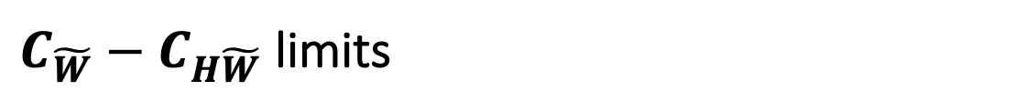
$C_{\tilde{W}}−C_{H\tilde{W}}$ limits

Slide 28
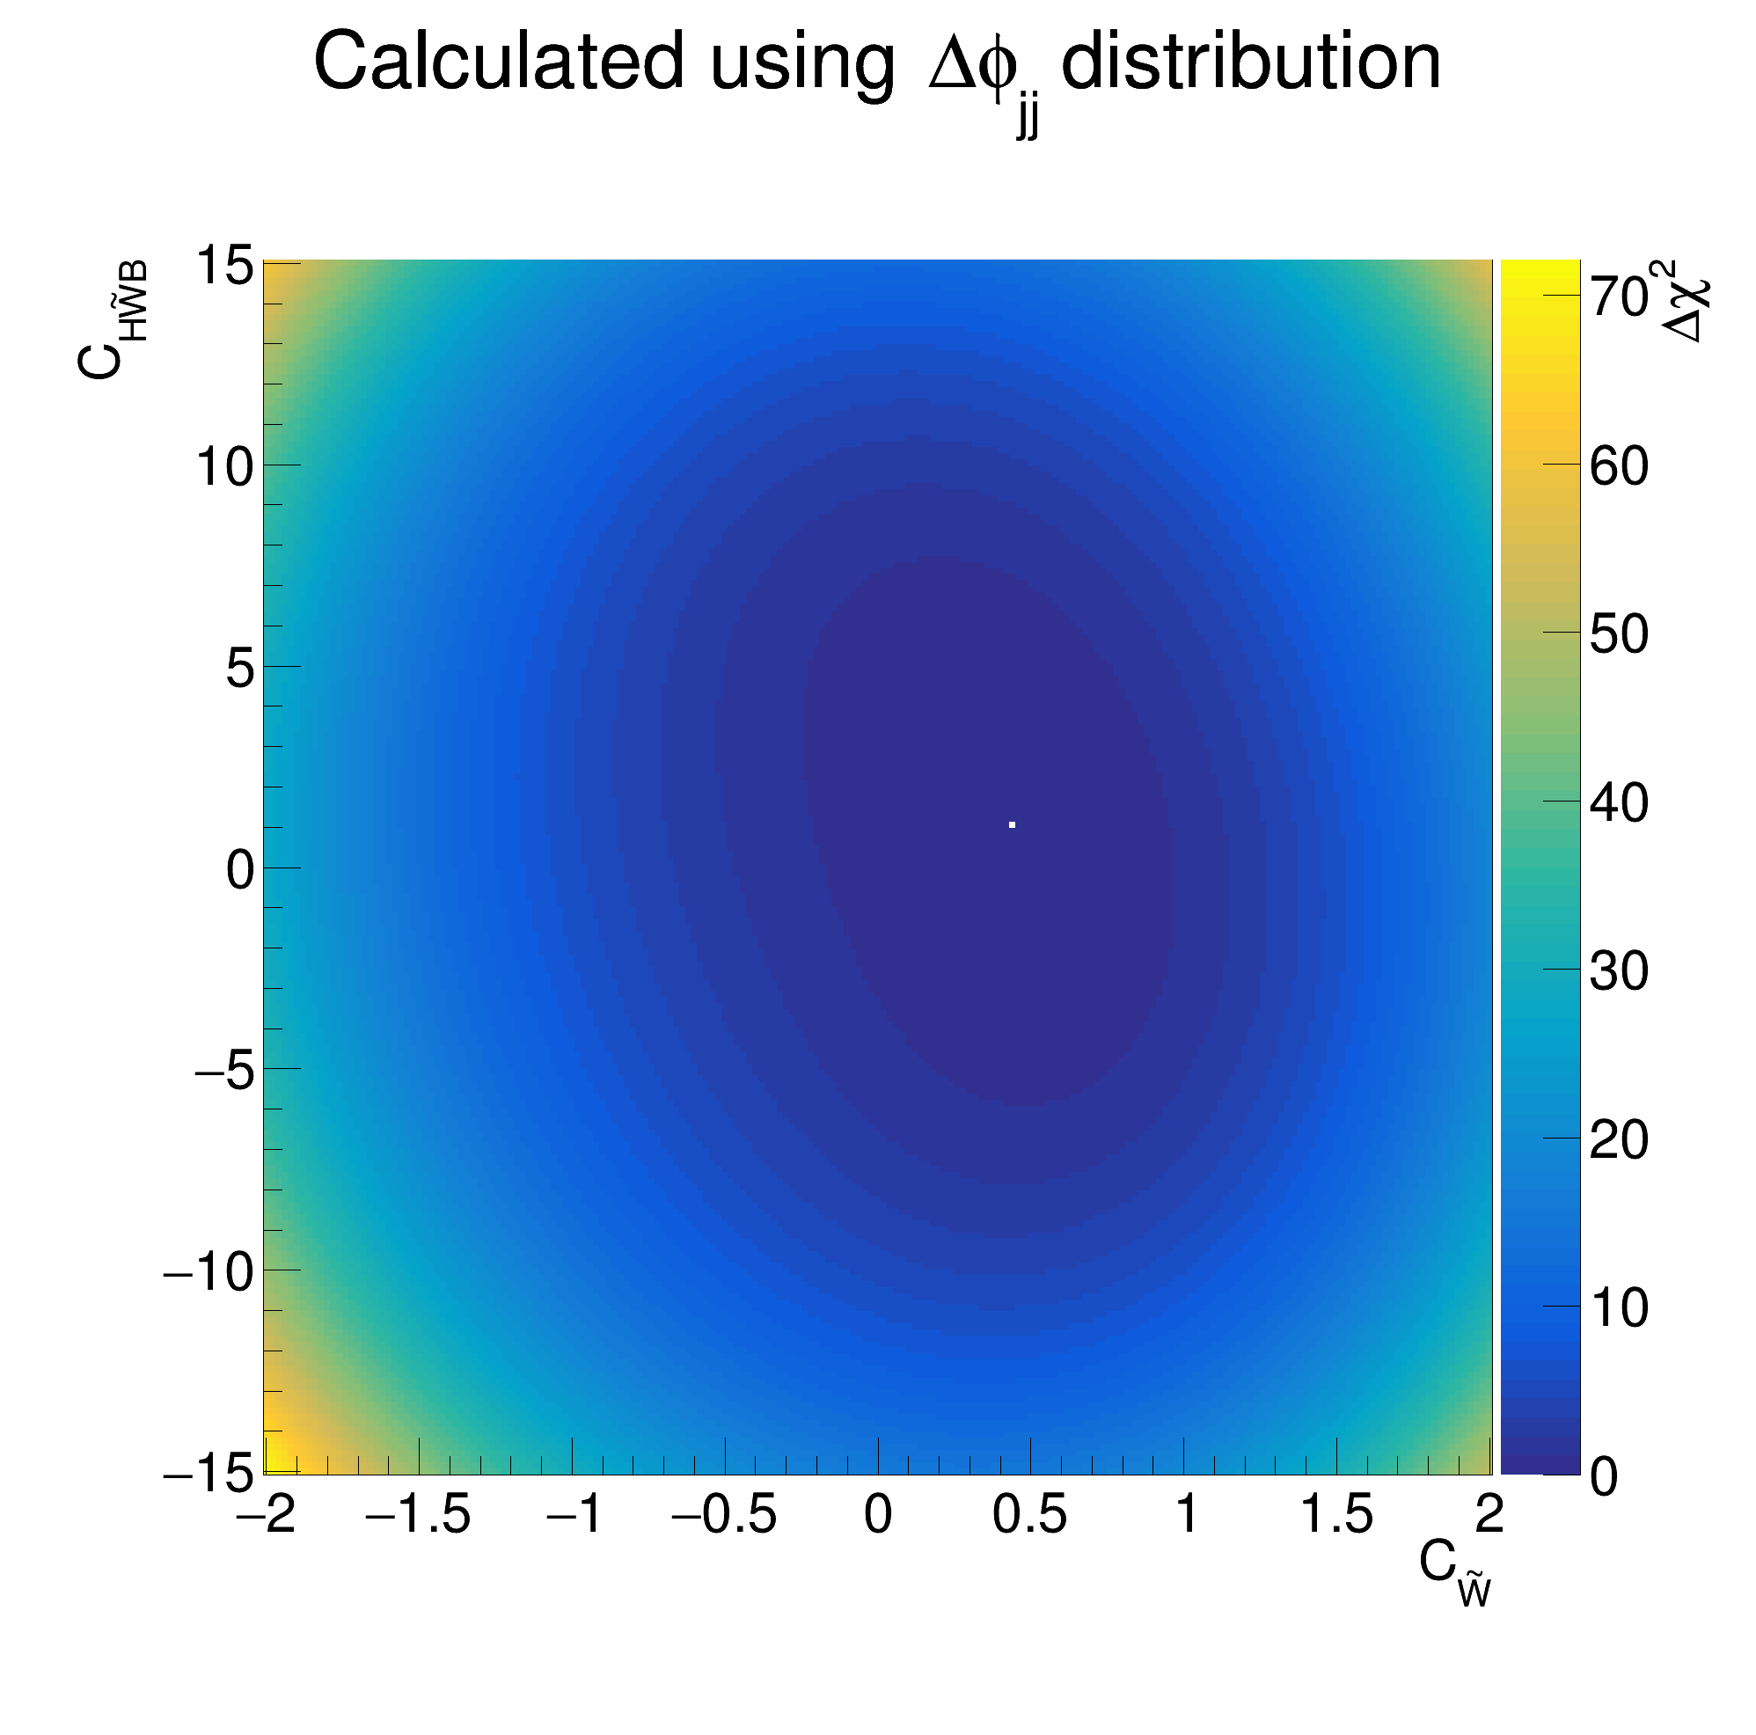
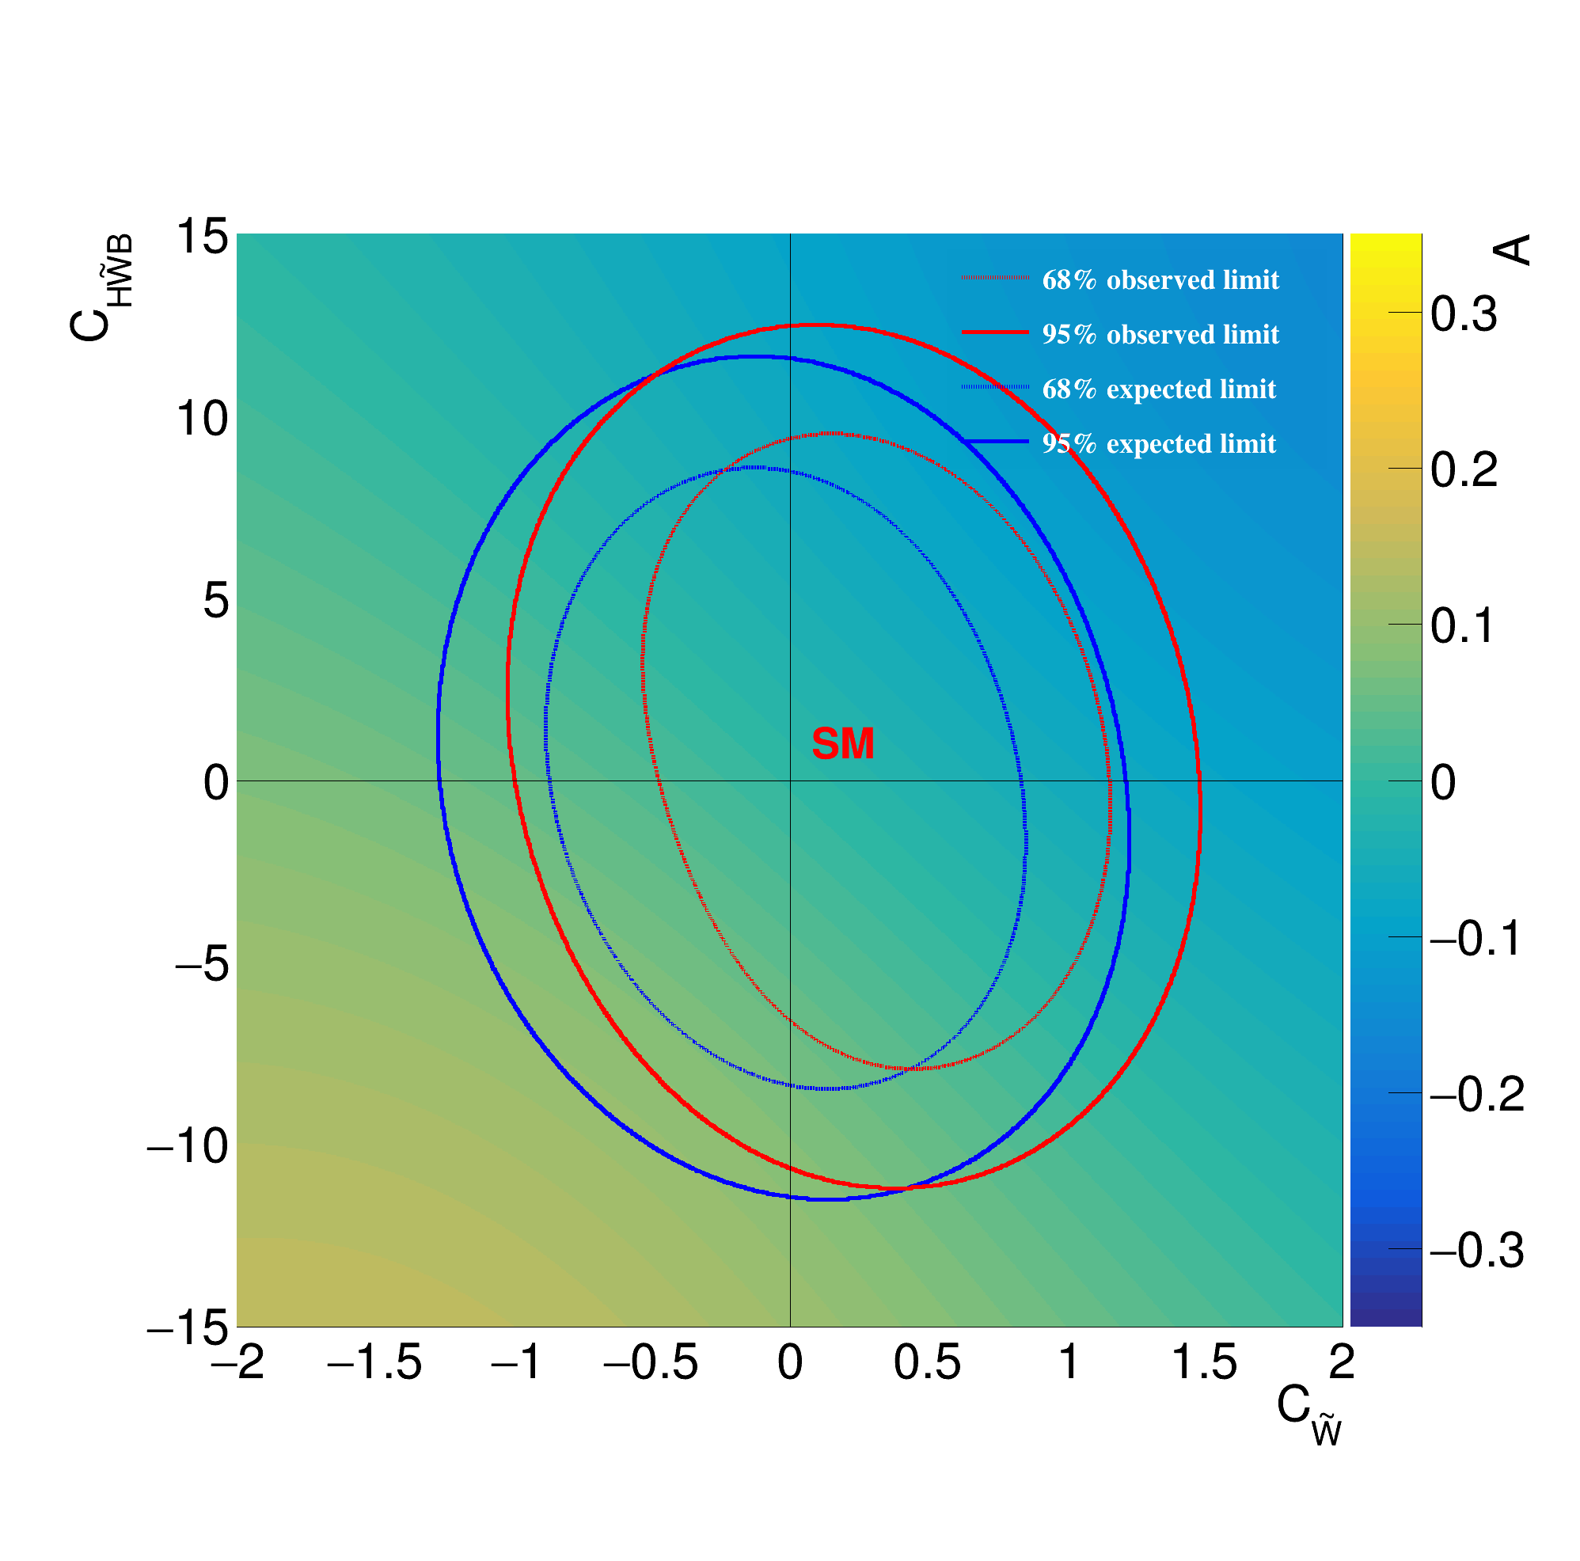
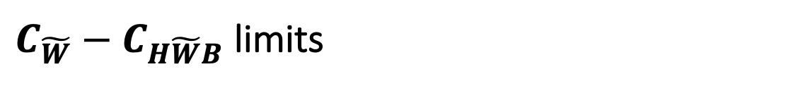
$C_{\tilde{W}}−C_{H\tilde{W}B}$ limits

Slide 29
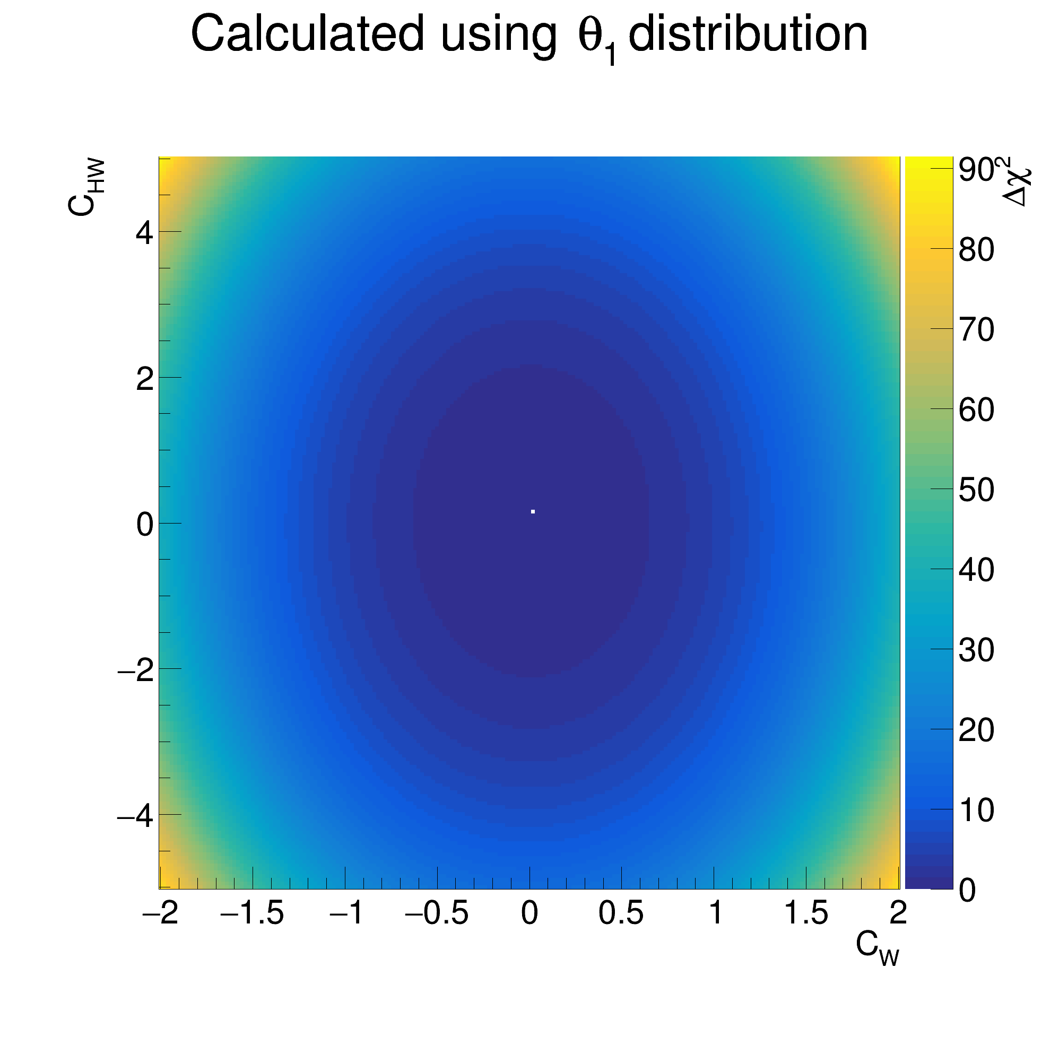
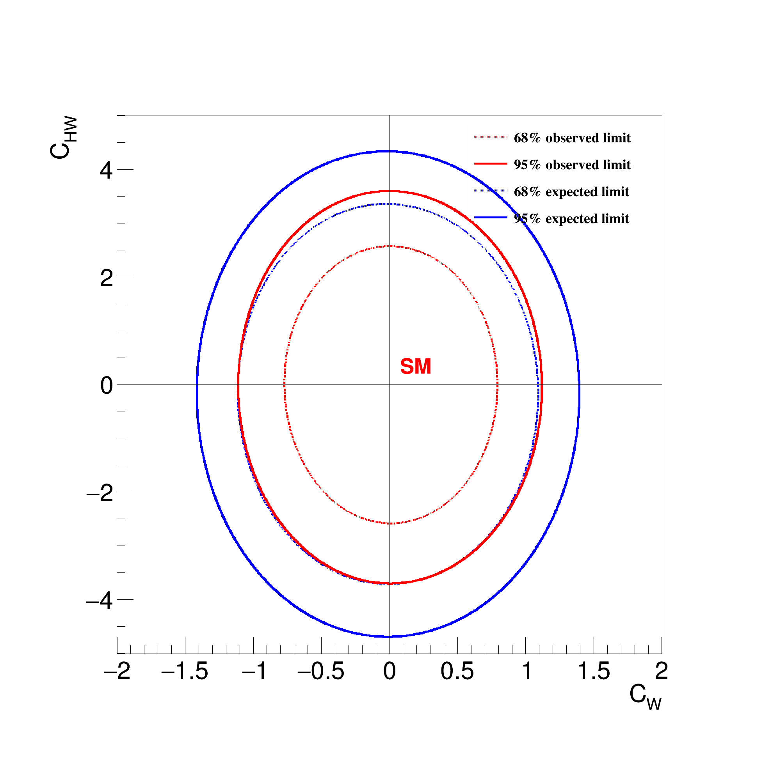
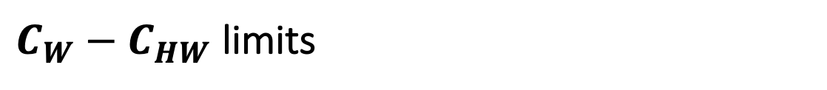
$C_{W}−C_{HW}$ limits

Slide 30
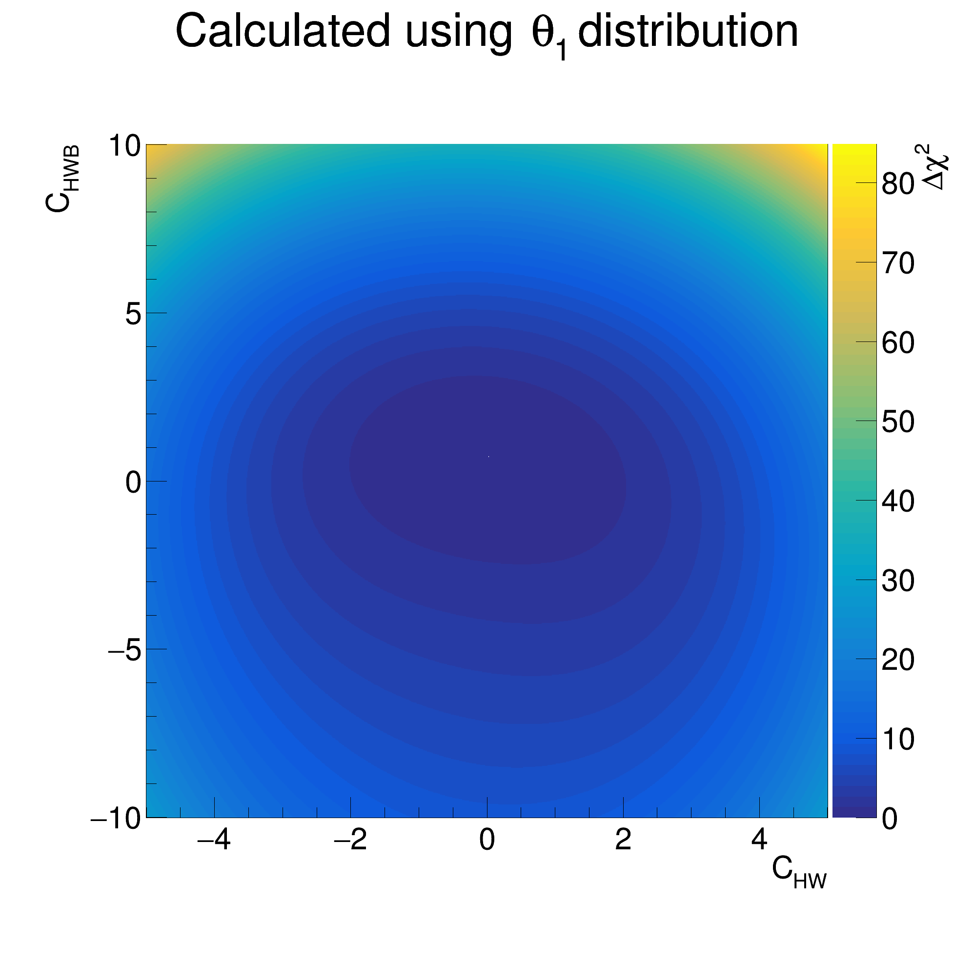
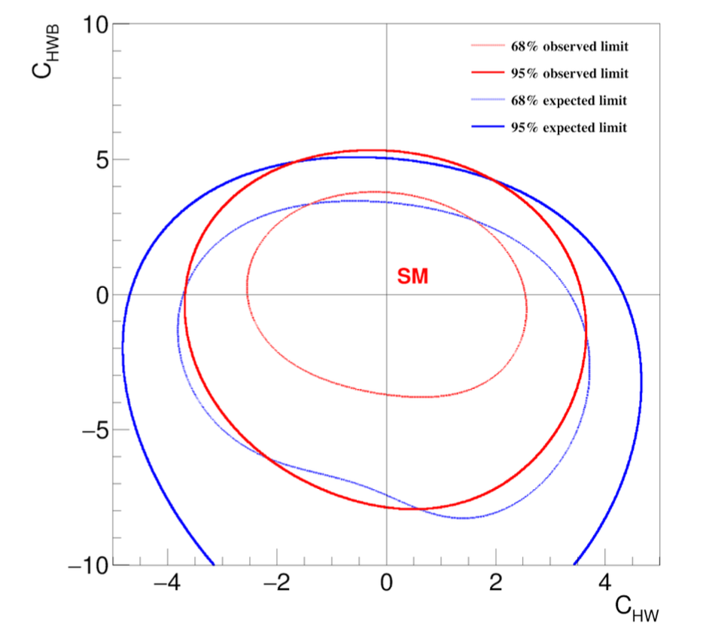

$C_{HW}−C_{HWB}$ limits

Slide 31
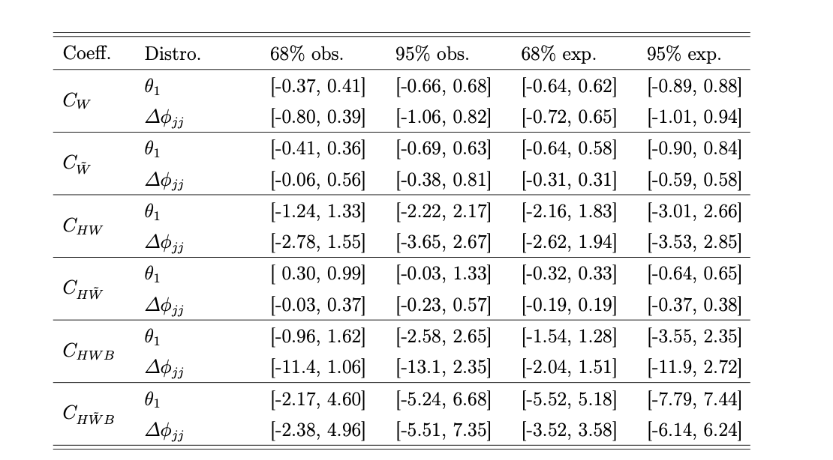
1-D limits

Slide 32
Conclusions on EFT investigation
The process of EW ZZjj with on-shell Z bosons shows good sensitivity to selected EFT operators in the fiducial region.
The model-independent technique shows good robustness and the CP-sensitive observables are proved useful.

Slide 33
Backup slides

Slide 34
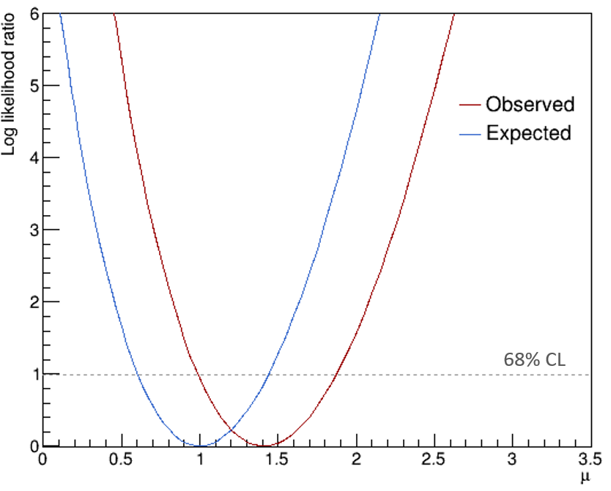
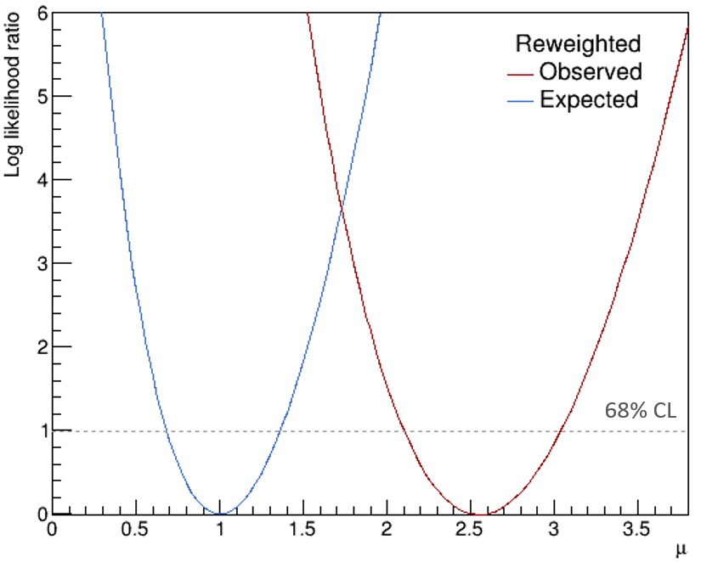
Log likelihood plots

Slide 35
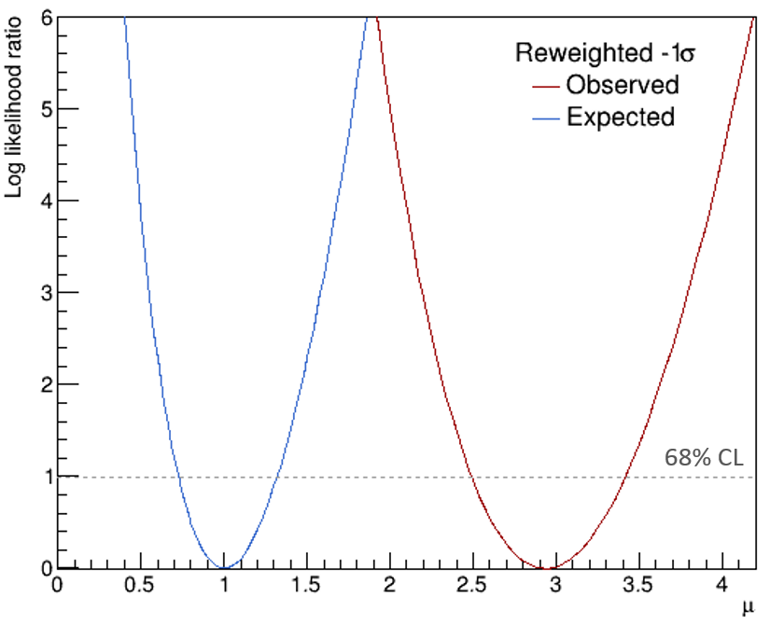
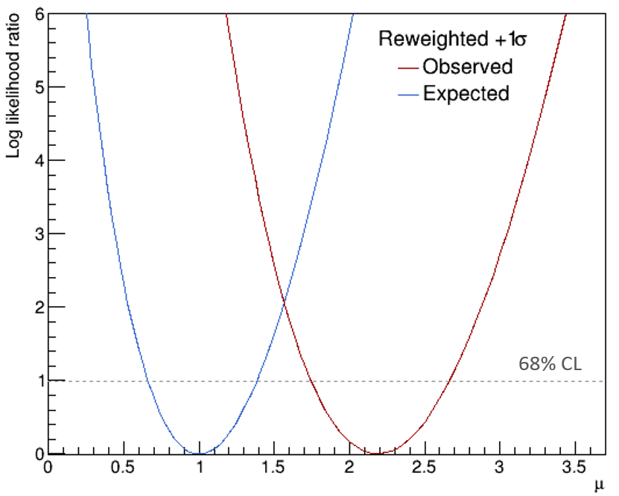
Log likelihood plots

Slide 36
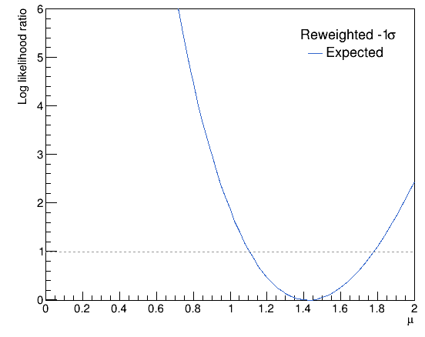
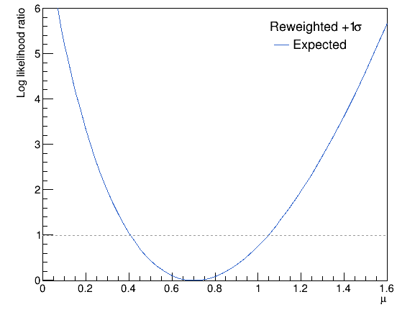

Log likelihood plots (systematic uncertainty)
m
m
68% CL
68% CL
Systematic uncertainty calculation for the reweighting method.

Slide 37

Log likelihood plots (systematics)
Minimum of log likelihood ratio at $\hat{μ}=0.68$.
Therefore, the systematic uncertainty of the nominal method was taken to be $±0.32$.
68% CL
Systematic uncertainty calculation for the nominal method.

Slide 38




Powheg Strong ZZjj sample reweighting fit
Gradient of nominal reweighting function:
$$m ± σ_{m}=−0.000187 ±0.000922$$
$$y = 0.000735x + 0.656$$
$$y = −0.000187x + 1.01$$
$$y = −0.00111x + 1.37$$

Slide 39

Powheg Strong ZZjj sample reweighted $m_{jj}$

